Slide 1


Project „Reformation of the Curricula on Built Environment in the Eastern Neighbouring Area“ [CENEAST] No. 530603-TEMPUS-1-2012-1-LT-TEMPUS-JPCR

Slide 2


CENEAST project (1)
CENEAST project aims to upgrade curricula of BSc/specialists, MSc and PhD programmes with new modules on energetically and ecologically sustainable, affordable and healthy built environment in universities of Belarus, Russia and Ukraine, to transfer the Bologna practices in education, develop a virtual interuniversity networked educational system, to train staff within the PC universities and to train at least 240 students.
Following activities were implemented in order to achieve the wider and specific objectives of the project:
  WP1. Management;
  WP2. Upgrading of BSc, MSc and PhD degree programmes;
  WP3. Development and Exploitation of the Virtual Interuniversity Networked Educational Centre;
  WP4. Monitoring and Reporting of Results;
  WP5. Dissemination.

Slide 3
CENEAST project (2)
Consortium:
  Vilnius Gediminas Technical University (Project coordinator)
  Alma Mater Studiorum – University of Bologna
  University of Salford/University of Huddersfield
  Tallinn University of Technology
  Belarusian State Technological University
  Yanka Kupala State University of Grodno
  Moscow State University of Civil Engineering
  Saint-Petersburg State Polytechnical University
  Kaliningrad State Technical University
  Moscow State Industrial University
  National Technical University of Ukraine
  National Technical University "Kharkiv Polytechnic Institute„
  Network among Italian researchers and teachers on management - SVIMAP Network
  Association INFOBALT

Slide 4
1. General management (1)
1.1. Steering Committee (CENEAST Administrative Unit and CENEAST Management Group) was established to implement project management activities.
  The CENEAST Administrative Unit as planned is formed by the Coordinator – Project manager – Prof PhD DrSc Artūras Kaklauskas (P1 VGTU), Financial Manager – Romualdas Česnavičius (P1 VGTU) and Secretary – Lina Pečiūrė (P1 VGTU).
  The CENEAST Management Group (CMG) is formed by the Coordinator – Prof PhD DrSc Artūras Kaklauskas (P1 VGTU), Financial Manager – Romualdas Česnavičius (P1 VGTU), Work Package Heads and Participating Universities Coordinators.
CENEAST Administrative Unit meets once a week to discuss project implementation activities and reporting.
CENEAST Management Group meets every 3-4 months (project meetings).
Other communication channels are e-mails,
skype, phone, Dropbox, CENEAST website.

Slide 5
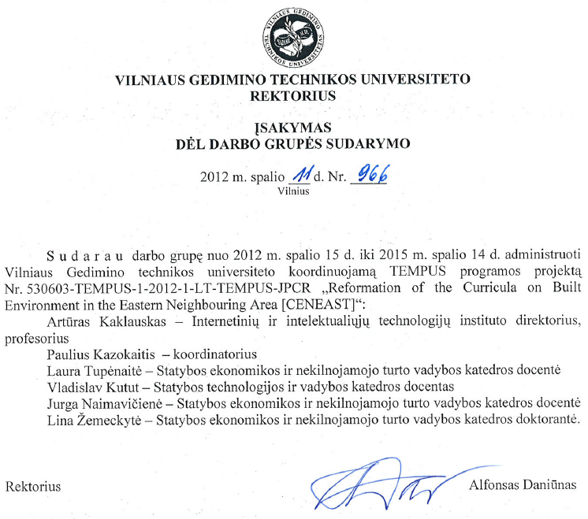
1. General management (2)
1.2. Project management group in Coordinating institution (VGTU) did not change. Project financier was involved in the 3rd project implementation month.
Different persons were involved in
project implementation activities
(WPs). The involvement of
specialists of their field guaranteed
the best quality of project results.

Slide 6
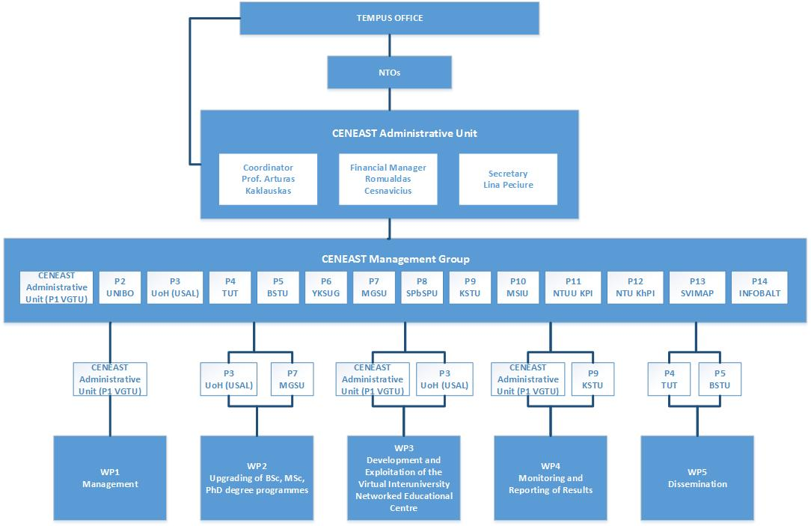
1. General management (3)
1.3.

Slide 7
1. General management (4)
1.4. Participating Universities Coordinators:
  Arturas Kaklauskas (P1 VGTU)
  Massimo Bianchi (P2 UNIBO),
  Dilanthi Amaratunga (P3 USAL/UoH),
  Irene Lill (P4 TUT),
  Nikolai Siniak (P5 BSTU),
  Yury Romanovski (P6 YKSUG),
  Igor Pichugin (P7 MGSU),
  Nikolai Vatin (P8 SPbSPU),
  Valeriy Beley (P9 KSTU),
  Andrey Safonov (P10 MSIU),
  Angela Piatova (P11 NTUU KPI),
  Irina Porunkova (P12 NTU KhPI),
  Renato Mele (P13 SVIMAP),
  Vilma Misiukonienė (P14 INFOBALT).

Slide 8
1. General management (5)
1.5. To ensure continuous communication and information spread among partners CENEAST Web site (http://www.ceneast.com) and Dropbox platform were developed. Communication is implemented through:
  11 meetings from the start of the project (every 3-4 months)
  Information on the project website
  Documents exchange via Dropbox
  E-mails
  Phone calls
  Skype calls
1.6. All conflicts between the project partners are solved during the meetings and fixed in the meeting minutes. The decisions are made fast during the discussions in CENEAST Management Group.

Slide 9
1. General management (6)
1.7. Meetings were highly important in creating of collaboration, common understanding, presenting and monitoring of achieved results, planning of future activities. Each meeting outcomes are provided in meeting minutes.
Total monitoring of the progress and achieved obtained results in relation to the CENEAST time schedule and academic years is performed by the Coordinator of the project. Coordinator also keeps records of documentation of the Project, keeps records of attendance lists and monitors Agenda, the outcomes and conclusions of the meetings.
The quality control of project outputs is carried out by internal and external experts, students and lecturers. They have submitted their reports on CENEAST modules.

Slide 10
1. General management (7)
1.8. A good cooperation between all CENEAST consortium members (4 higher education institutions from 4 EU countries, 8 higher education institutions from 3 PC countries and 2 associations from European countries) was established at the beginning of the Project. Each partner has a contact person who is responsible for internal communication and outcomes developed by each partner. Project coordinator communicates and collects the information from each contact person in partner institution. No difficulties were observed in the project management.
1.9. The intermediate report was submitted in time. All partners prepare their reports in time of just with small delays which do not have any negative impact to the project results.

Slide 11
2. Document management
Following documents were prepared for the monitoring visit:
2.1. Partnership agreement is signed between each partner and project coordinator
2.2. Follow-up matrix for activities
2.3. Organigram of the project
2.4. Copies of project website and Dropbox
2.5. Minutes of the last coordination meetings
2.6. Participants list
2.7. Agendas for all project meetings
2.9. Information about project dissemination
2.10. Peer review reports and students evaluations
2.11. Examples of products. All products are on the project Dropbox.

Slide 12
3. Project content (1)
3.1. So far all the planned activities have been going quite well, without any difficulties. No problems requiring special measures have occurred in CENEAST. The coordination of the activities is quite satisfactory with good feedback from the staff of the other participating universities.
3.2. All delays are solved in a short time. Partners are prompted via e-mail and during the meetings. For the financial reports: money are transferred only after the reports are submitted.

Slide 13
3. Project content (2)
3.3. Project work plan

Slide 14
3. Project content (3)
3.4. All the expected results and activities, assumptions and overall objectives are still valid 100% as the changes contribute to them directly. Besides, biometric and augmented reality technologies, which were not included in the original application, will improve the efficiency of our intelligent library, intelligent tutoring system, and intelligent knowledge assessment system. This, in part, is compensated by the cooperation with another CENEAST Lifelong Learning Programme, namely Learning Augmented Reality (LARGE) mentioned before.

Slide 15
3. Project content (4)
3.5. Planned outcomes | Planned | Implemented up to 31/05/2015
Number of cooperating universities | 12 | 12
Number of upgraded programs available | 5 | 5
Number of newly developed modules: BSc/specialists MSc PhD modules | 16 9 5 2 | 22 8 12 2
Virtual interuniversity networked educational centre available | 1 | 1
Number of involved labour market organizations in the preparation of new modules | 2 | 2
Number of staff trained | 36 educators and 32 employees | 84 educators and 32 employees
Number of students who studied the newly developed modules | 240 | 193
CENEAST Web site available | 1 | 1

Slide 16
3. Project content (5)
3.6. The level of stakeholder participation in the implementation of the CENEAST depends on the stakeholders. The stakeholders with the closest ties to the departments/faculties contribute more and in more direct ways, those with no direct ties are less involved. External experts and organisations were involved in the module preparation.
3.7. No, there is no resource schedule available.
3.8. There were changes in the budget between budget headings not more than 10 %. These changes do not have any impact to the managing/delivering the project's activities/results.

Slide 17
3. Project content (6)
3.9. There are no negative effects on the target groups.
3.10. All project activities were successfully implemented except some problems with the equipment purchases. All the equipment is foreseen to purchase until the end of the project and will be used for the study process.
3.11. Collaboration among Project participants already helped to share the experience among different institutions and furthermore, develop new and strengthen existing relations for further collaboration in education and research.

Slide 18
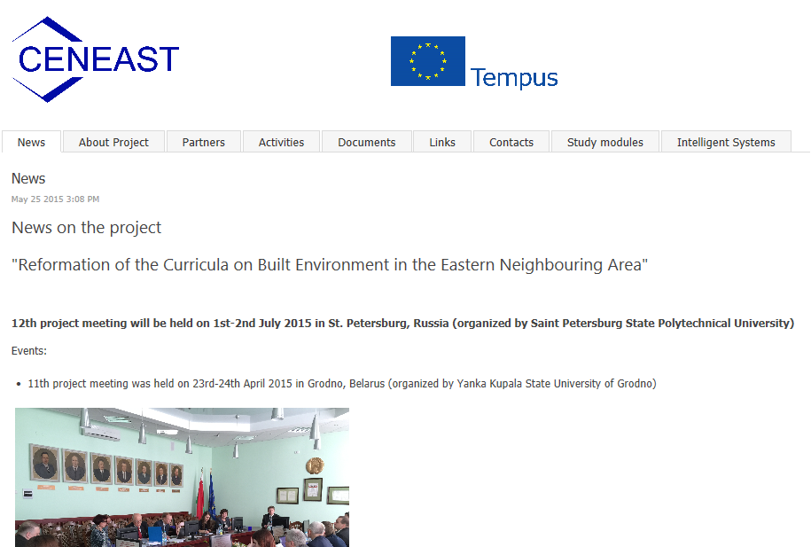
Project website
www.ceneast.com

Slide 19
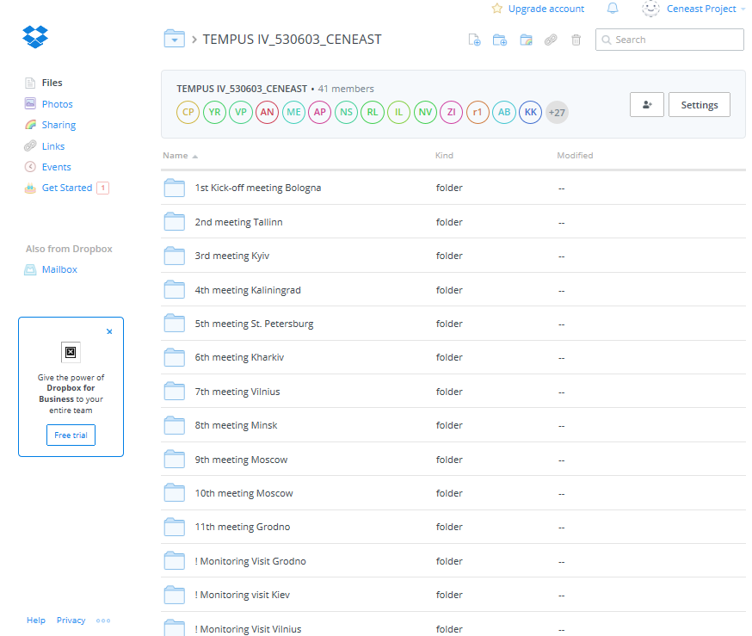
Project Dropbox

Slide 20
Project deliverables
D1.1. Development of communication infrastructure
D1.2. Continual management and reporting
D2.1. The framework report for the common curricular
D2.2. Report on common grounds for teaching and learning
D2.3. Module specifications and teaching materials
D3.1. Development of e-interuniversity networked system
D3.2. Development of the virtual research environment
D3.3. Training, lecturing and guest visits
D3.4. Training of students
D4.1. Report on internal CENEAST monitoring results
D4.2. Report on external CENEAST monitoring results
D4.3. Analyses and recommendations
D5.1. Dissemination through branch organizations
D5.2. Dissemination through international conferences
D5.3. Dissemination through websites
D5.4. Printed dissemination material

Slide 21
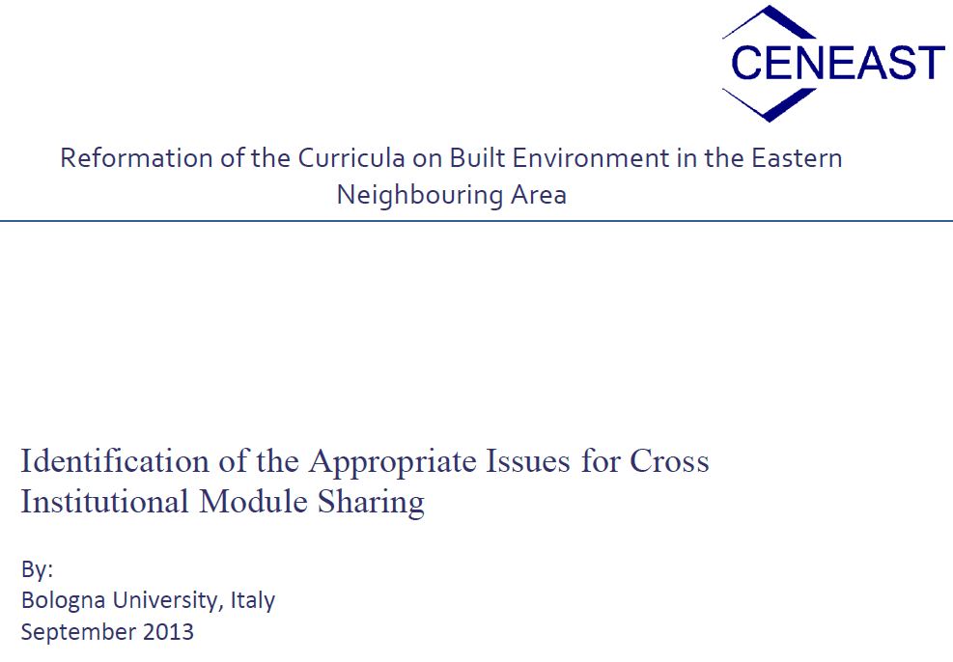
The framework report for the common curricular
Prepared by each partner university in English or Russian, analysing separate countries. Saved in the project Dropbox.

Slide 22
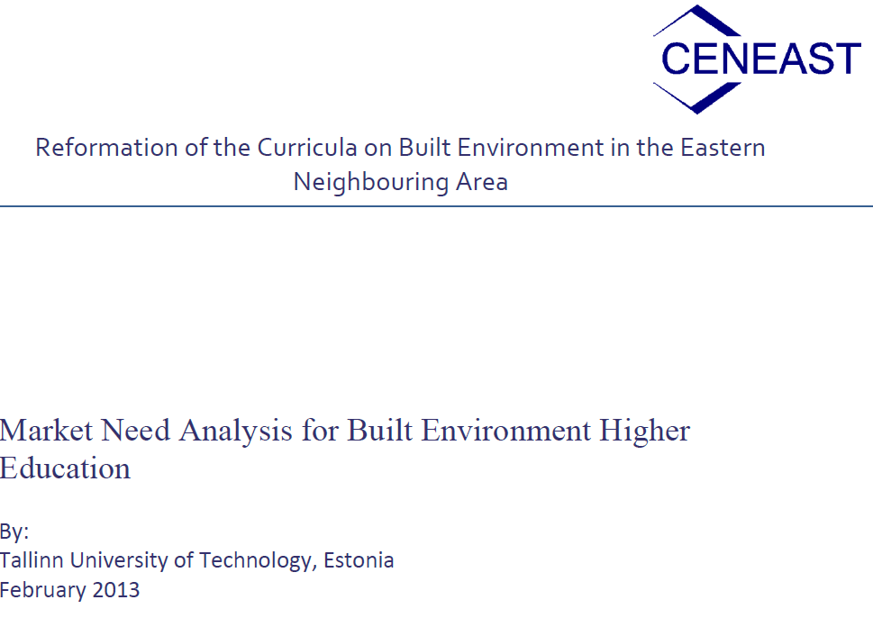
Report on common grounds for teaching and learning
Prepared by each partner university in English or Russian, analysing separate countries. Saved in the project Dropbox.

Slide 23
Module specifications and teaching materials (1)
Confirmed BSc modules
Renewable Energy, responsible university: KSTU with NTUU "KPI"
Energy Efficiency in Engineering Systems, responsible university: KSTU with NTUU "KPI"
Energy Audit, responsible university: NTUU "KPI" with MGSU
Construction Materials for Sustainable Built Environment, responsible university: YKSUG
Sustainable Urban Design, responsible university: MGSU
Green Built Environment, responsible university: MGSU
Advanced construction technologies for energy efficient buildings, responsible university: SPbSPU
Project management in construction and construction site management, responsible university: SPbSPU

Slide 24
Module specifications and teaching materials (2)
Confirmed MSc modules
Environmentally sustainable cities development, responsible university: NTU "KhPI" with NTUU "KPI", MSIU and VGTU
Green Built Environment, responsible university: MGSU
Sociological methods used for sustainable urban development, responsible university: MGSU with UNIBO and TUT
Human safety, natural and technogenic problems in the 21st century, responsible university: NTUU "KPI" with USAL, NTU "KhPI" and SPbSPU
Smart House, responsible university: MSIU
Smart Built Environment, responsible university: MSIU
Construction Investments, responsible university: TUT

Slide 25
Module specifications and teaching materials (3)
Confirmed PhD modules
Integrated analysis of the build environment life cycle, responsible university: VGTU with BSTU
Resilience Management, responsible university: USAL

Slide 26

Printing of books

Slide 27
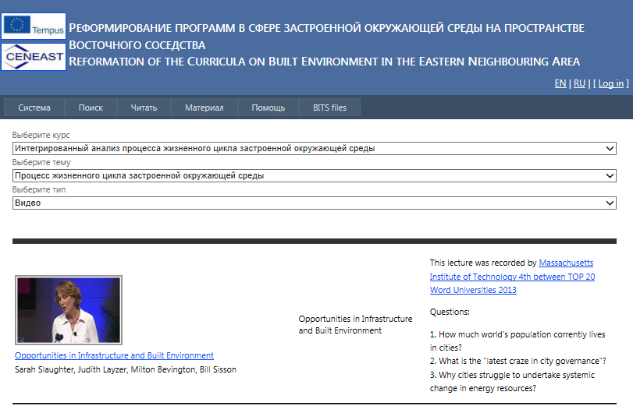
Intelligent systems
http://iti.vgtu.lt/tempus/

Slide 28
Project dissemination (1)

Slide 29
Project dissemination (2)
Websites:
  www.ceneast.com
  http://www.vgtu.lt/vgtu-international/current-projects/-international-academic-projects/53919
  http://www.cib2014.org/proceedings/ceneast.html
  http://www.ttu.ee/faculty-of-civil-engineering/department-of-building-production-3/dbp-research/projects-26/ceneast/
  http://www.scienzeaziendali.unibo.it/en/research/research-centres-and-projects/tempus
  www.en.spbstu.ru/TEMPUS-CENEAST/
  http://www.klgtu.ru/interact/projects/ceneast.php
  http://www.salford.ac.uk/built-environment/research/research-centres/disaster-resilience/key-research-projects/ceneast
  www.grsu.by/en/news/8_3777.html
  https://www.etis.ee/portaal/projektiAndmed.aspx?VID=999823ba-e6fa-4ce1-a3cc-d10c8b618dfb&PersonVID=37554&lang=en&FromUrl0=isikuProjektid.aspx
  http://kpi.ua/en/node/7194
  http://www.ttu.ee/faculty-of-civil-engineering/department-of-building-production-3/dbp-research/projects-26/ceneast/
  http://www.ec.kharkiv.edu/mp.html
  http://www.dilanthiamaratunga.net/index.php?option=com_content&view=article&id=114&Itemid=106
  ...

Slide 30
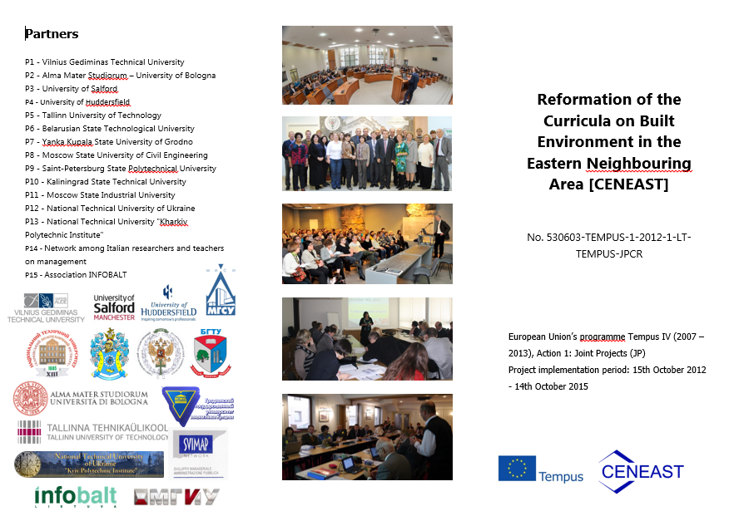
Project dissemination (3)

Slide 31
Thank You!

